Slide 1

Books for Children at birth-Kindergarten
Lisa
Thomas Pham
Elsa
Niveen

Slide 2

Contents
In this presentation we’ll be covering 8 ideas:
1. Books for the children upon birth.
2) How it’s important.
3. How it can help them become better readers in the future.
4) The Number of words Addressed to children differs across income groups (Hart and Risely’s Chart 2)
5.Children’s Vocabulary differs across Income groups (Hart and Risely’s Chart 3)
6) At Birth Children are ready to learn
7. Infants are good listeners.
8) Summary
9. Works Cited

Slide 3
Books for the children upon birth
We believe hospitals should not only give the mother medications after she leaves the hospital.
The nurses should provide the mother with books also. “With the infant program traditionally overseen by the health nurse…” (Cheeseman, Press, Sumsion. Pg.39)
Books are knowledge and knowledge can shape the child’s world around him/her.
The earlier they learn to read the more successful they can do in school.

Slide 4

How’s it important?
IT’s important at an early age they can learn a lot from a parent.
Parents are also important in an infant’s life.
Family support helps an Infant succeed in life.
IF the infant has a family to support them at a young age they won’t feel neglected.
With Family support if anything goes wrong they have a plan B to fall back on.

Slide 5

helps them become better readers.
We believe parents should red to them at a very young age.
Parents should read to their children also even in the wombs.
The sooner they learn the better they’ll do in school.
Early reading helps infants with Language.
“…children from families on welfare heard about 616 words per hour, while those from working class families heard around 1,251 words per hour, and those from professional families heard roughly 2,153 words per hour.”

Slide 6

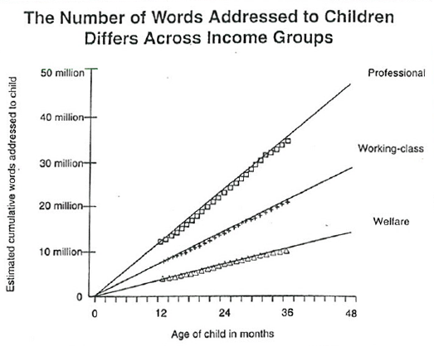
Hart and Risely Chart 2

Slide 7

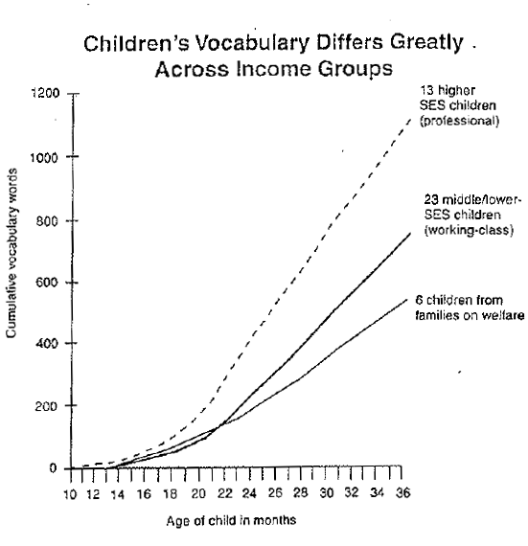
Hart and Risely Chart 3

Slide 8

infants Are Really Good Listeners.
Infants are the best listeners.
They really are good listeners so reading to them is a good idea.
As infants their brains are still growing so the knowledge they get from a parent will help them.
The sooner they learn the better off they’ll be.
It’s our job to keep them safe from physical and Emotional harm. So they get the chance to learn from their parents.
“…primarily in need of protection from physical danger and emotional harm—cared for while ‘waiting to learn’.” (Cheeseman, Press, Sumsion. Pg.39)

Slide 9

At Birth Children are ready to learn
Children at birth are ready to learn.
Once you read to your child even at birth they will learn a lot from you.
They can’t tell you but they’re really listening to your every word and letter.
You don’t see it but it’s happening as you read to them a book.

Slide 10

Summary
I hope you enjoyed this presentation.
Now you know how important it is to read to your children at a young age.
They can learn a lot from you.
All you need to do is read to them.
You’ll be amazed of how fast they learn.
The sooner they read the better future they’ll have.
How much Early Childhood Education changed.

Slide 11
Works Cited
http://web.b.ebscohost.com.ezproxy.skylinecollege.edu/ehost/pdfviewer/pdfviewer?sid=494e9b72-dbce-4cc4-b7bf-0b2f6d0a387f%40sessionmgr112&vid=3&hid=128
http://literacy.rice.edu/thirty-million-word-gap

Slide 12

questions or comments

